Slide 1

Exploratory Data Analysis
<Case Study : Cab Industry>
<04/09/2021>

Slide 2

Agenda
Problem Statement
Objective
Data Understanding
Data Exploration and Data Assumption
Data Summary
EDA using Graphical Analysis
EDA using Tabular Analysis
Recommendations

Slide 3
PROBLEM STATEMENT
XYZ is a private firm in US. Due to remarkable growth in the Cab Industry in last few years and multiple key players in the market, it is planning for an investment in Cab industry.
Objective : To perform exploratory Data analysis on the Data and to find insights which will help XYZ company to make the investment in the right company

Slide 4
DATA UNDERSTANDING
There are 4 datasets provided as follows
1) City Dataset – This dataset contains the information about the total cab users & the total population of all the cities
2) Cab Dataset – It contains the information of transaction of cab user and the details associated with it.
3) Transaction ID Dataset – This dataset contains payment information of each transaction.
4) Customer ID Dataset – This dataset contains information about the customers using the cab services.
Master Dataset – Firstly Cab Dataset is merged with City Dataset with the column named “CITY”. Then Transaction ID Dataset is merged with Customer ID Dataset on the column named Customer ID. Then finally the two merged Datasets are merged into one by using Transaction ID column resulting into one Master Dataset.

Slide 5
DATA EXPLORATION & DATA ASSUMPTION
Data Exploration and feature transformation
There are no null values present in the dataset. There are some outliers present in the column name Price charged.
All the Data types is checked ad the wrong ones are converted into the right ones
The date values are sliced into different columns naming Date, Month and Year.
Profit is calculated by Price charged – Cost of a trip.Profit/Km is calculated by Profit / Km travelled And Cost/km is calculated by Cost of trip / Km travelled.
Data Assumption
There is no Cab Strike during this period of data collected.
Data for Total Cab Time Duration and Timing of the Cab ride is not known. Therefore outliers are not removed from the Cost of the trip
There is no Cab data for San Fransico, so that column in City data is not used.
Some of the transactions had Cost of trip more than the Price charged, which is very unlikely thing to happen. Therefore the inaccurate data is removed.
All the cab rides for both the companies are considered from the time period of data is from 31/01/2016 to 31/12/2018.
Loyalty is considered when a specific user takes a Cab ride more than 10 times in an entire time duration of 3 years.

Slide 6

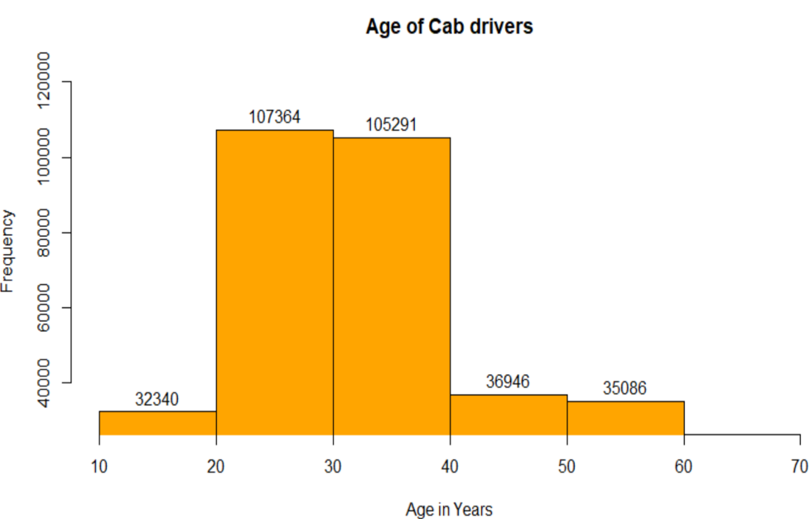
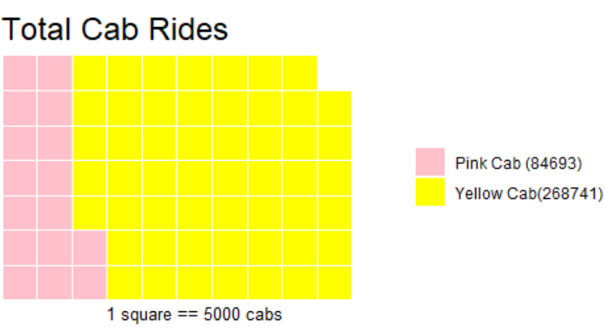
DATA SUMMARY
The Data Table shows that people prefer paying more by Card rather than Paying By Cash.
The histogram of Age of Cab drivers is visualised. By analyzing it we can
say that more number of drivers are in Age range of 20-30 and 30-40.
The total number of Age drivers from Age range 18-20 is almost
equivalent to Cab drivers of Age ranging from 40-50 and 50-60.
As shown in waffle chart, in these 3 years people refer
Yellow cab almost 3 times than Pink Cab.

Slide 7
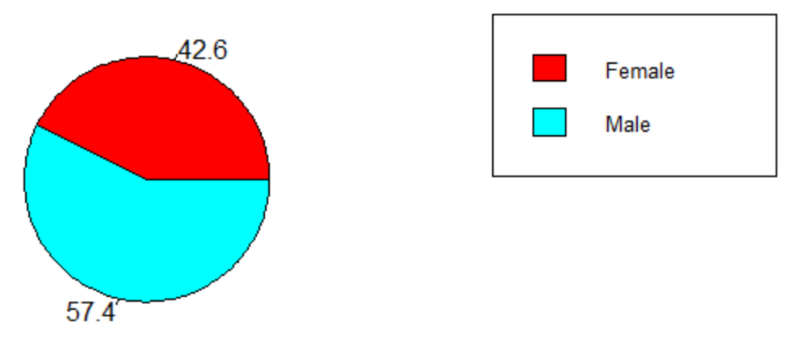
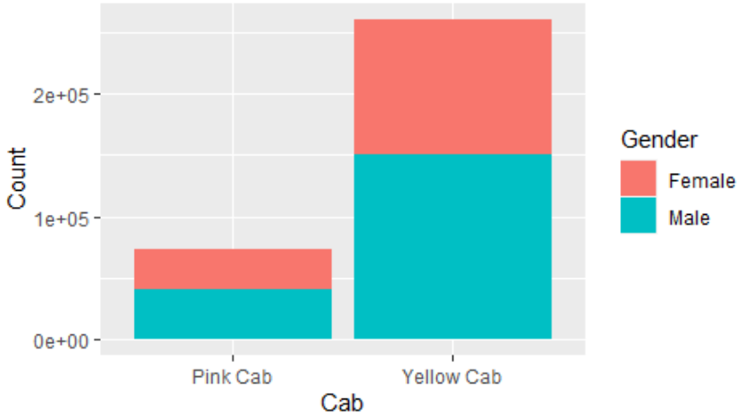
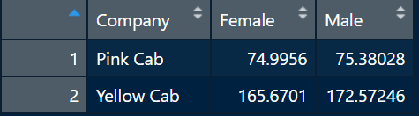
EDA USING GRAPHICAL ANALYSIS -1
EXPLORING BY GENDER
There are more number of Male Cab drivers than Female Cab drivers
More number of people have preferred Yellow cab
than Pink Cab for both the Genders. Male uses more
Cab than Female
Average Profit contribution per Gender and Cab company is shown in
Data table. Male Contributes more to Profit than Females. Yellow Cab
Has more average profit than the Pink Cab for both of the Genders

Slide 8
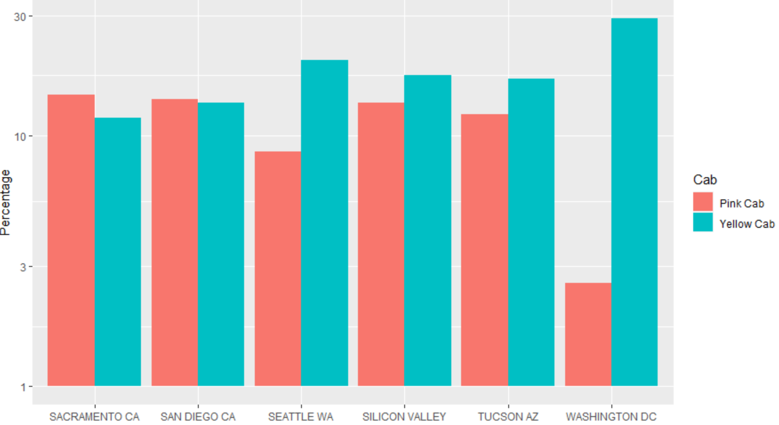
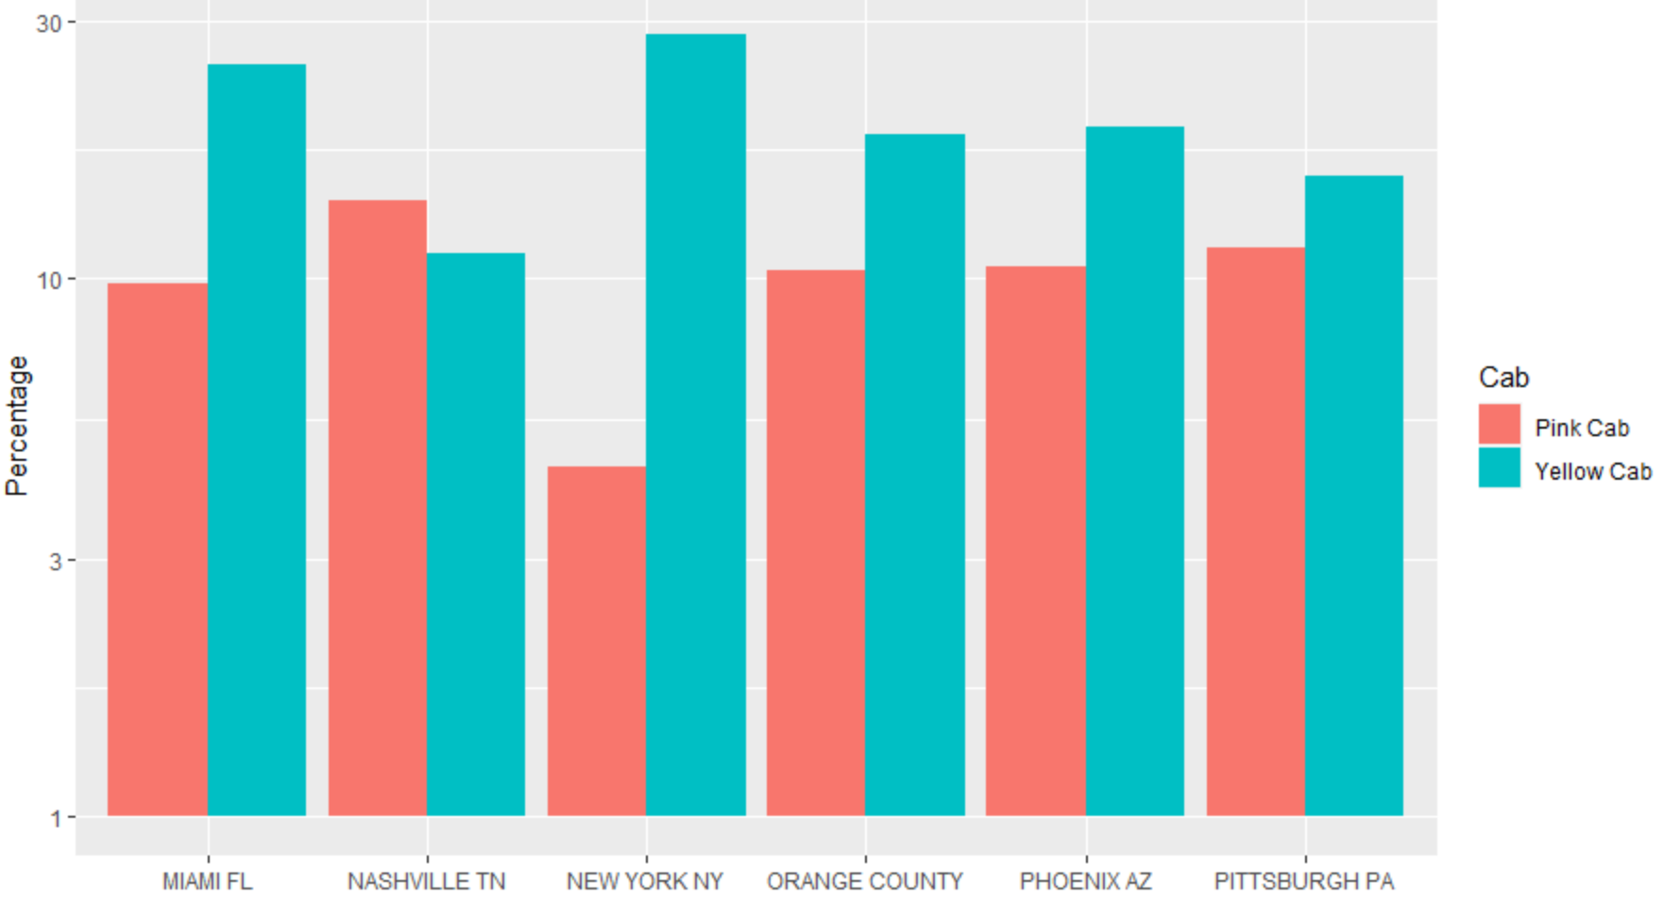
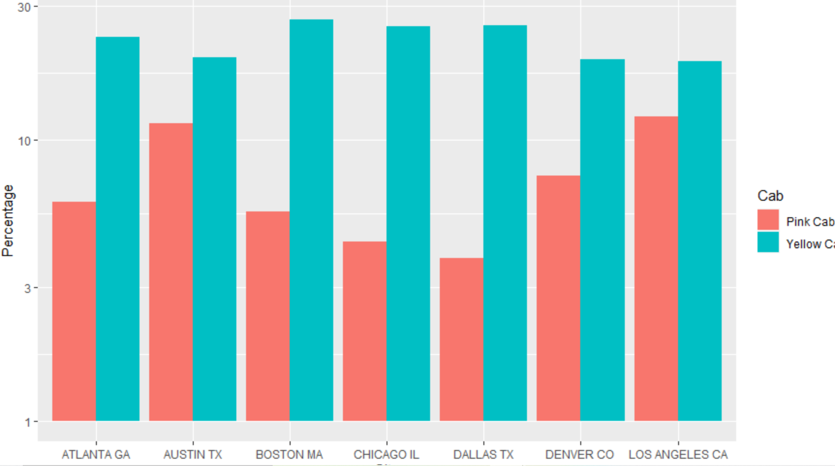
EDA USING GRAPHICAL ANALYSIS -2
Total Percentage of Cab Users across Cities
This graph shows the total percentage of Cab Users
Preferring Yellow Cabs and Pink Cabs across all the cities.
Out of total Cab users more percentage users of Cab prefer yellow
cab than pink Cab except for the cities like Nashville, Sacramento
and San Diego

Slide 9
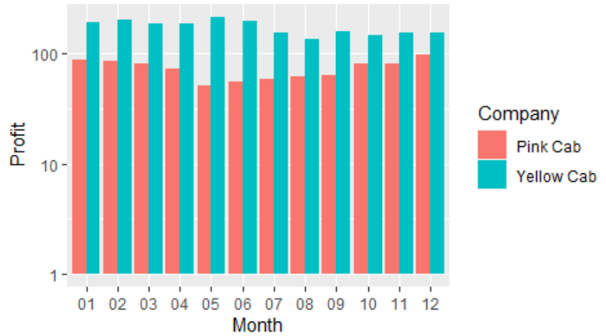
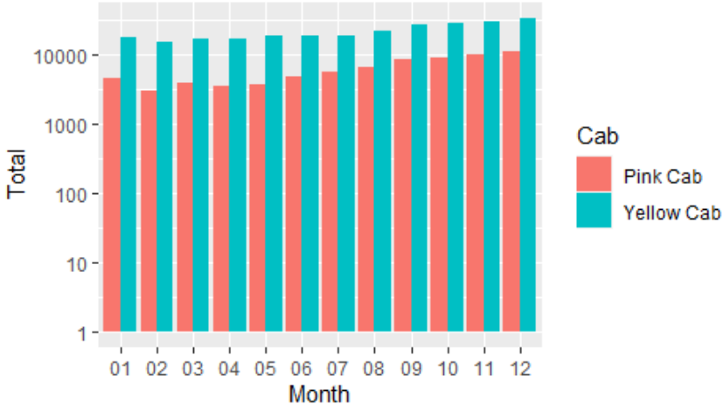
EDA USING GRAPHICAL ANALYSIS -3
ANALYSIS PER MONTH
Avg Profit Per Month Total Demand per Month
The average profit per month graph shown on the left hand side and Total Demand for Each cab is shown in right hand side graph. Average profit collected for every month is more for Yellow cab.
No seasonality trend as such but in winter holidays demand for cabs are more than in summer. Demand for yellow cab is more than pink Cab

Slide 10
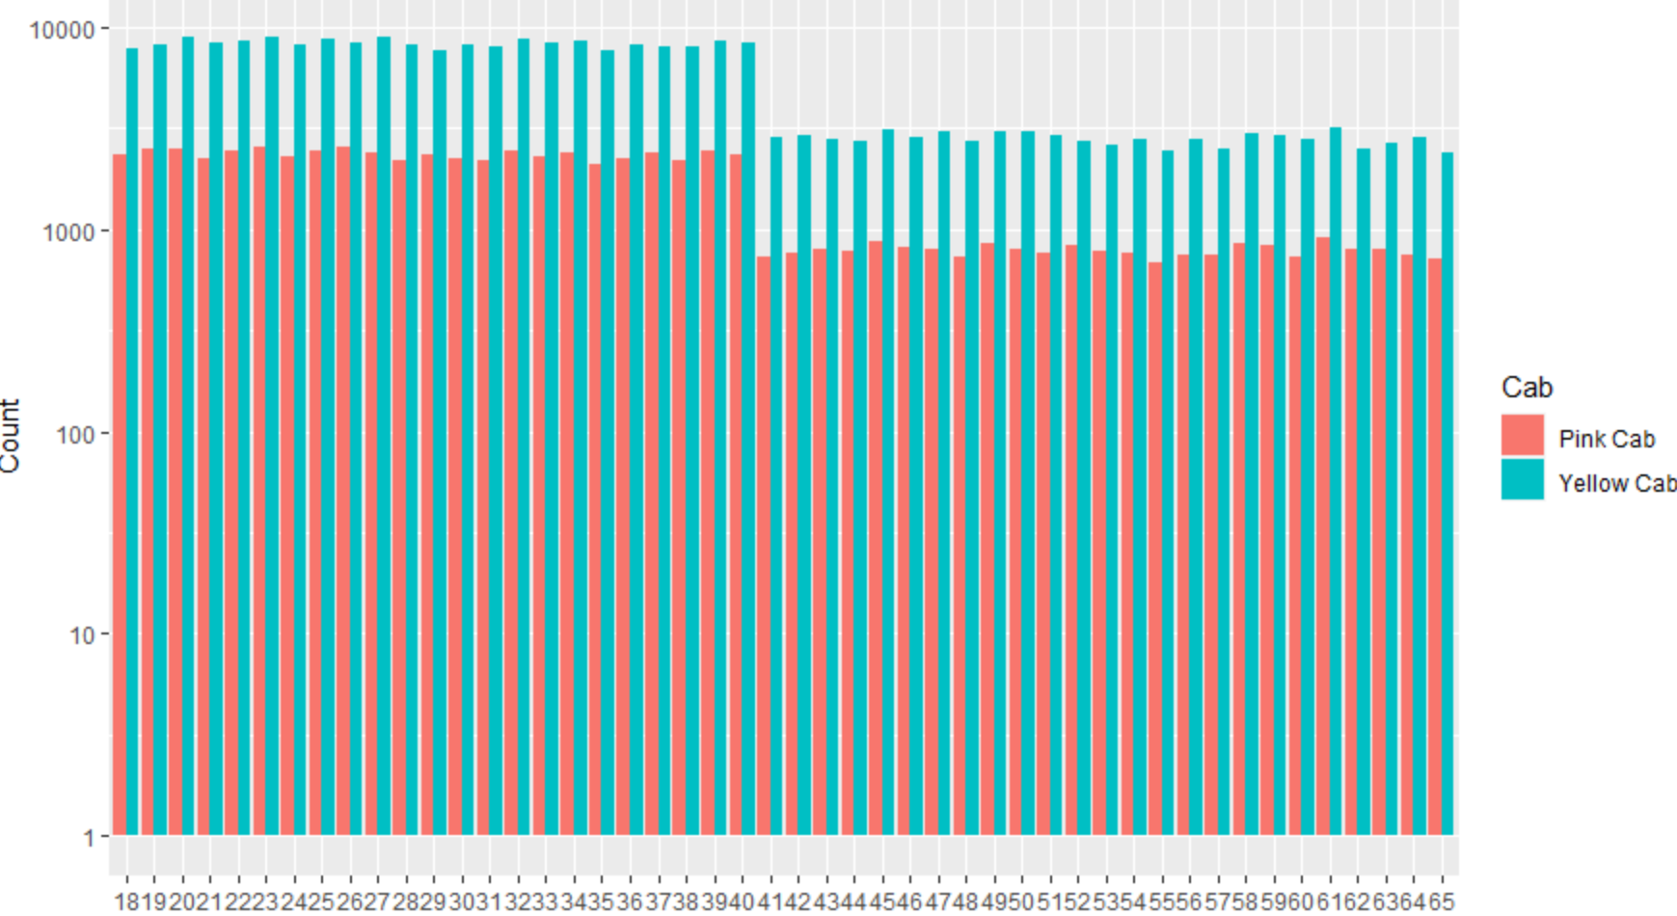
EDA USING GRAPHICAL ANALYSIS -4
DEMAND FOR CAB VS AGE
High demand for both of cabs
before age of 40. Demand of
cab decreases for the age 40
and above. The demand for
Yellow Cab is more than Pink
Cab for each and every age

Slide 11
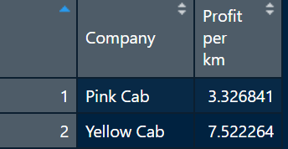
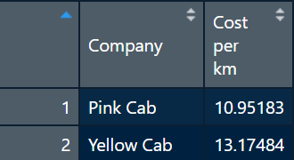
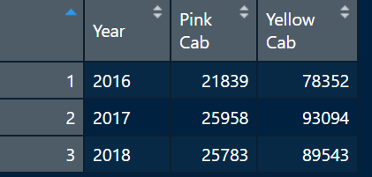

EDA USING TABULAR ANALYSIS
EXPLORING OTHER ASPECTS OF DATA
Yellow Cab charges more cost per km than Pink Cab
Profit per km is more than twice for yellow cab as
compared to Pink Cab
Average profit per year for respective cab is shown in
left hand side of the table. Yellow car has more average
Profit per year. 2017 Marks to be the highest profit year
as compared to others.
The condition for loyal customer is that they should have
taken cab atleast 10 times in 3 year period. So looking at
at right hand side of data table Pink cab has only 264 loyal
Customers whereas Yellow Cab has 9897 loyal users

Slide 12
Observations and Recommendations
More number of customers are loyal to Yellow Cab than Pink Cab
Out of total Cab users more number of users prefer yellow can than pink cab except for the cities San diego, Nashville, Sacramento.
Cost per km is more for yellow cab than pink cab
Profit per km is more than twice for yellow cab as compared to pink cab
Not only Cab Demand but also average profit per year for year 2017 is the highest
No seasonality trend as such but in winter demand for cabs are more than in summer.
Demand for yellow cab is more than pink
Average profit contribution for every age is more for yellow cab than pink cab
High demand for both of cabs before age of 40. Demand of cab decreases for the age 40 and above.
At every age, yellow cab more than pink cab
Both Male and Profit prefer Yellow cab than Pink Cab
Cab Demand for Male is higher than female
Yellow Cab ride are used by customers almost 2.5 times more than Pink Cab
There from above recommendations we can conclude that investment in Yellow Cab would be much better than pink cab

Slide 13
Thank You

